Slide 1

ABC Call Volume Trend Analysis
By Nayan Jain

Slide 2
Project Description
ABC Call Volume Trend project objective is to address the issue of abandoned calls and optimize workforce allocation to maintain a low abandonment rate of 10%.
By analyzing 23 days of inbound call data, we will identify patterns and trends to enhance the customer experience.
The dataset includes information such as agent names, agent IDs, queue times (waiting duration before connecting to an agent), call times, time buckets, call durations, call seconds, and call statuses (abandon, answered, transferred).

Slide 3
Approach
Dataset Familiarization: Thoroughly understood the provided dataset, including column details and project requirements, to establish a solid foundation for analysis.
Data Cleaning: Ensured data accuracy and relevance by removing unnecessary columns, resulting in a clean dataset for analysis.
Data Analysis: Utilized Excel and employed pivot tables and graphs to perform calculations, derive insights, and identify patterns within the dataset.
Project Report: Created a concise and visually engaging report using PowerPoint, presenting findings, insights, and visualizations effectively.

Slide 4
Tech-Stack Used:
MS-Excel
Assumptions:
Name | Value
Agent working days per week | 6
Agent unplanned holidays per month | 4
Agent working hours per day | 9 hours
Agent lunch and snack time per day | 1.5 hours
Agent actual working hours per day | 7.5
Agent occupied in actual working hours per day | 60%
Average agent working time per day | 4.5 hours (16200 seconds)

Slide 5
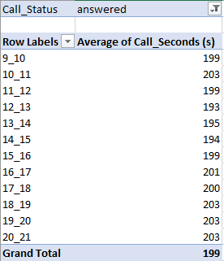
A. Calculate the average call time duration for all incoming calls received by agents (in each Time Bucket).

Slide 6
Insights of A
Average Call Time Duration:
Total average call time for answered calls by agents: 198.6 seconds.
Highest average call duration observed in time buckets 10-11, 18-19, 19-20, and 20-21, with an average duration of 203 seconds.
Lowest average call duration recorded in time bucket 12-13.

Slide 7
B. Show the total volume/ number of calls coming in via charts/ graphs [Number of calls v/s Time]. You can select time in a bucket form (i.e. 1-2, 2-3, …..)
Row Labels | Calls Received | % Calls Recieved (s)
9_10 | 9588 | 8.13%
10_11 | 13313 | 11.28%
11_12 | 14626 | 12.40%
12_13 | 12652 | 10.72%
13_14 | 11561 | 9.80%
14_15 | 10561 | 8.95%
15_16 | 9159 | 7.76%
16_17 | 8788 | 7.45%
17_18 | 8534 | 7.23%
18_19 | 7238 | 6.13%
19_20 | 6463 | 5.48%
20_21 | 5505 | 4.67%
Grand Total | 117988 | 100.00%

Slide 8
Insights of B
Number of Calls Per Time Bucket:
Time bucket 11-12 received the highest percentage of calls, comprising 12.40% of total calls.
Following closely, time bucket 10-11 accounted for 11.28% of the calls.
In contrast, time buckets 20-21 and 19-20 had the lowest call volumes, with percentages of 4.67% and 5.48%, respectively.

Slide 9
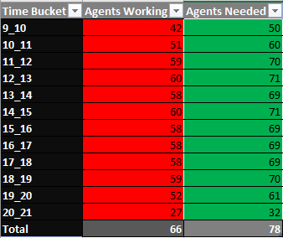
C. As you can see current abandon rate is approximately 30%. Propose a manpower plan required during each time bucket [between 9am to 9pm] to reduce the abandon rate to 10%. (i.e. You have to calculate minimum number of agents required in each time bucket so that at least 90 calls should be answered out of 100.)

Slide 10
Insights of C
Manpower Plan to Reduce Abandonment Rate:
To achieve a targeted abandonment rate of 10%, a total of 79 unique agents were deemed necessary.
Initially, with an abandonment rate of 30%, the workforce comprised 66 unique agents.

Slide 11
D. Let’s say customers also call this ABC insurance company in night but didn’t get answer as there are no agents to answer, this creates a bad customer experience for this Insurance company. Suppose every 100 calls that customer made during 9 Am to 9 Pm, customer also made 30 calls in night between interval [9 Pm to 9 Am] and distribution of those 30 calls are as follows:
Now propose a manpower plan required during each time bucket in a day. Maximum Abandon rate assumption would be same 10%.

Slide 12
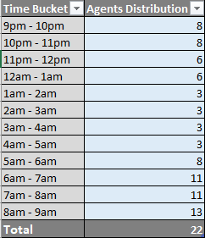

Slide 13
Insights of D
Night-time Call Volume and Agents Required:
During the 9:00 a.m. to 9:00 p.m. timeframe, there were 100 calls made by customers.
Correspondingly, during the night from 9:00 p.m. to 9:00 a.m., there were 30 calls made for every 100 calls during the day.
To adequately handle the night-time calls, a manpower of 22 unique agents would be required.

Slide 14
Result
1) Project Overview:
Analyzed incoming call data to assess agent performance and workload, considering factors like work schedule, unplanned leaves, and call durations.
Identified time buckets with varying call time durations and observed call distribution trends across different periods.
2) Manpower Planning:
Proposed a manpower plan to increase call answer rate to 90%, addressing customer satisfaction and reducing abandon rate.
Calculated minimum agent requirements per time bucket to achieve target abandon rate, accounting for work hours and other tasks.
Factored in night-time call handling and determined 22 unique agents required for overnight coverage.
3) Efficient Resource Allocation:
Agents can handle additional calls beyond estimated workload with full effort, utilizing available time effectively.
4) Key Insights:
Project provided valuable insights for agent performance, call distribution, and effective manpower planning.
Implementation of proposed plan will enhance customer service and optimize agent resources.
5) For a more in-depth analysis, please click on the link provided below:
ABC Call Volume Trend Analysis.xlsx

